Slide 1
RDBMS
Meftah Jaâfer
Introduction to Databases Checkpoint

Slide 2
Summary
Introduction
MySQL
PostgreSQL
SQL Server
System Properties Comparison Microsoft SQL Server vs. MySQL vs. PostgreSQL
Conclusion

Slide 3
Introduction
A relational database management system (RDBMS) is a collection of programs and capabilities that enable IT teams and others to create, update, administer and otherwise interact with a relational database
. RDBMSes store data in the form of tables, with most commercial relational database management systems using Structured Query Language (SQL) to access the database.
The relational model uses the basic concept of a relation or table. RDBMS is the basis for SQL, and for database systems like MS SQL Server, IBM DB2, Oracle, MySQL, PostgreSQL, MariaDB, and Microsoft Access.

Slide 4
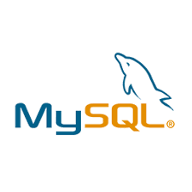
MySQL
MySQL happens to be one of the most popular databases, according to DB Engines Ranking. It’s a definite leader among SQL solutions, used by Google, LinkedIn, Amazon, Netflix, Twitter, and others. MySQL popularity has been growing a lot because teams increasingly prefer open-source solutions instead of commercial ones.
Price: the database solution is developed by Oracle and has additional paid tools; the core functionality can be accessed for free.
Language: MySQL is written in C++; database management is done with Structured Query Language.

Slide 5
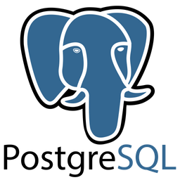
PostgreSQL
A tried-and-proven relational database that is known for supporting a lot of data types, and rich functionality.
Some developers go even as far as to claim that it’s the most advanced open-source database on the market. It’s definitely a highly universal solution.
Price: open-source
Language: C

Slide 6
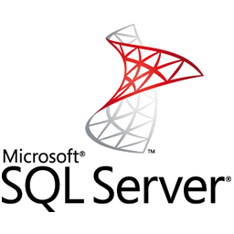
SQL Server
SQL Server is a commercial solution. It’s preferred by companies who are dealing with large traffic workloads on a regular basis. It’s also considered to be one of the most compatible systems with Windows services.
The SQL Server infrastructure includes a lot of additional tools, like reporting services, integration systems, and analytics. For companies that manage multiple teams, these tools make a big difference in day-to-day work.
Price: the database has a free edition for developers and small businesses but only supports 1 processor and 1GB of memory. For a server, users need to pay $931.

Slide 7
Data Changes
Here we evaluate the ease that the data can be modified with and the database defragmented. The key priority is the systems’ flexibility, security, and usability.
Row updates
This criterion refers to the algorithms that a database uses to update its contents, speed, and efficiency.

Slide 8
Data Changes
MySQL : have a solution that updates data automatically to the rollback storage. If something goes wrong, developers can always go back to the previous version.
PostgreSQL: developers insert a new column and row in order to update the database. All updated rows have unique IDs. This multiplies the number of columns and rows and increases the size of the database, but in turn, developers benefit from higher readability.
SQL Server: the database has three engines that are responsible for row updates. The ROW Store handles the information on all previous row updates, IDs, and modified content. The in-memory engine allows analyzing the quality of an updated database with a garbage collector.
=> Among these three, SQL Server offers perhaps the most flexibility and efficiency, because it allows monitoring updated rows and columns, collecting errors, and automating the process.

Slide 9

Defragmentation
When developers update different parts of an SQL database, the changes occur at different points of the systems and can be hard to read, track, and manage.
Therefore, maintenance should include defragmentation – the process of unifying the updated database by assigning indexes, revisiting the structure, and creating new pages. The database frees up the disk space that is not used properly so that a database can run faster.

Slide 10
Defragmentation
MySQL offers several approaches to defragmentation – during backup, index creation, and with an optimize table command having that options for table maintenance.
PostgreSQL allows scanning the entire tables of a data layer to find empty rows and delete the unnecessary elements. By doing so, the system frees up the disk space.

Slide 11
Defragmentation
SQL Server offers an efficient garbage collector that doesn’t create more than 15-20% of overhead. Technically, developers can even run garbage collector on a continuous basis, because it’s that efficient.
=> Overall, MySQL and SQL Server offer more of defragmentation methods that PostgreSQL does. They consume less CPU and provide more flexible settings.

Slide 12
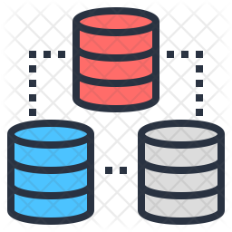
DATA Queries
Buffer Pool :
=> Some systems call a buffer to pull cache, but regardless of terminology, their goal is to summarize the algorithms that systems use to process user queries and maintain connections.
MySQL offers a scalable buffer pool – developers can set up the size of the cache according to the workload. Moreover, MySQL allows dividing cache by segments to store different data types and maximize isolation.

Slide 13
DATA Queries
Buffer Pool :
PostgreSQL isolates processes even further than MySQL by treating them as a separate OS process. Each database has a separate memory and runs its own process. On the one hand, management and monitoring become a lot easier, but on the other, scaling multiple databases takes a lot of time and computing resources.
SQL Server also uses a buffer pool, and just like in MySQL, it can be limited or increased according to processing needs. All the work is done in a single pool, with no multiple pages, like in PostgreSQL.
=> If your priority is to save computing resources and storage, choose flexible solutions: the choice will be between MySQL vs SQL Server. However, if you prefer clear organization and long-term order, PostgreSQL, with its isolated approach, might be a better fit.

Slide 14
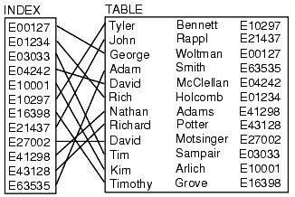
DATA Queries
Indexes :
The way a database handles indexes is essential because they are used to locate data without searching for a particular row. Indexes can refer to multiple rows and columns. You can assign the same index to files, located in the different places in the database, and collect all these pieces with a single search.

Slide 15
DATA Queries
Indexes :
MySQL organized indexes in tables and clusters. Developers can automatically locate and update indexes in their databases. The search isn’t highly flexible – you can’t search for multiple indexes in a single query. MySQL supports multi-column indexes, allowing adding up to 16 columns.
PostgreSQL also supports index-based table organization, but the early versions don’t include automated index updates . The solution also allows looking up many indexes in a single search. The multi-column settings are also more flexible than in MySQL – developers can include up to 32 columns.

Slide 16
DATA Queries
Indexes :
SQL Server offers rich automated functionality for index management. They can organize in clusters and maintain the correct row order without manual involvement. The solution also supports multiple-index searches and partial indexes.
=> Having flexible index settings allows looking up information faster and organizing multiple data simultaneously.

Slide 17
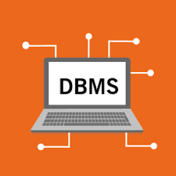
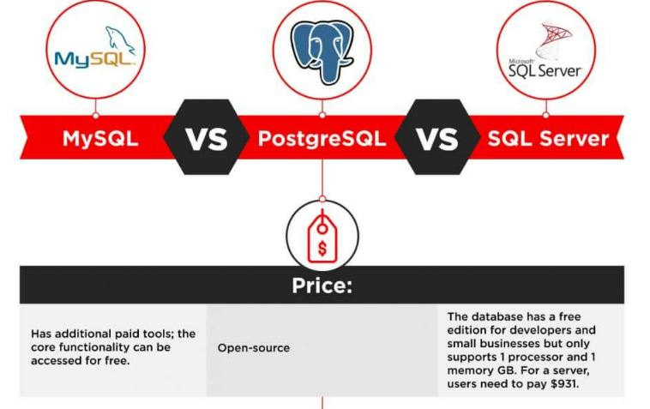
System Properties Comparison Microsoft SQL Server vs. MySQL vs. PostgreSQL

Slide 18
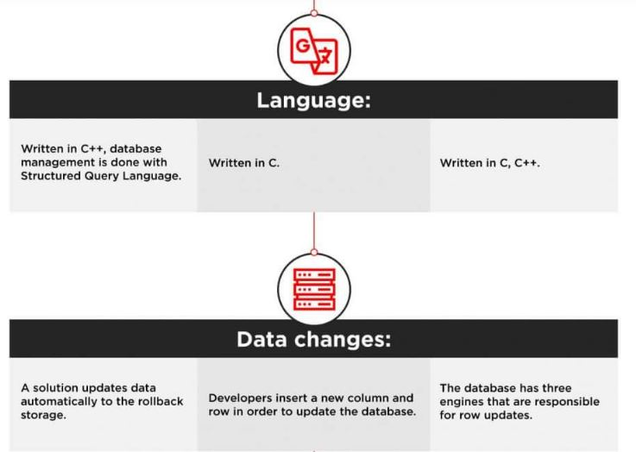
System Properties Comparison Microsoft SQL Server vs. MySQL vs. PostgreSQL

Slide 19
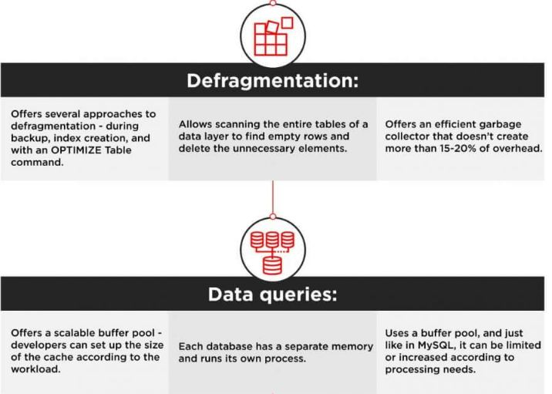
System Properties Comparison Microsoft SQL Server vs. MySQL vs. PostgreSQL

Slide 20
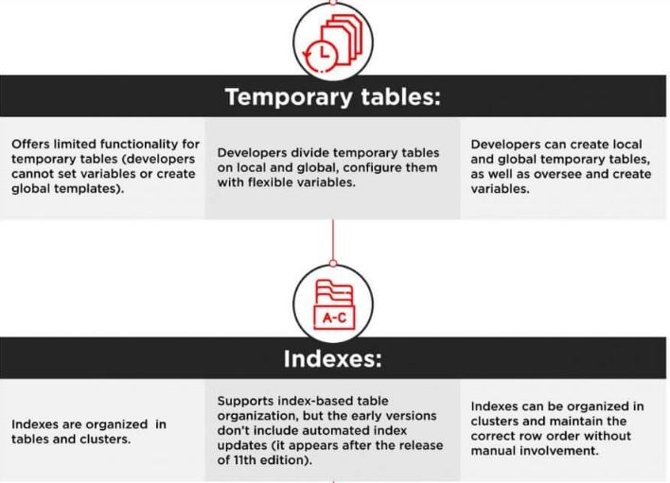
System Properties Comparison Microsoft SQL Server vs. MySQL vs. PostgreSQL

Slide 21
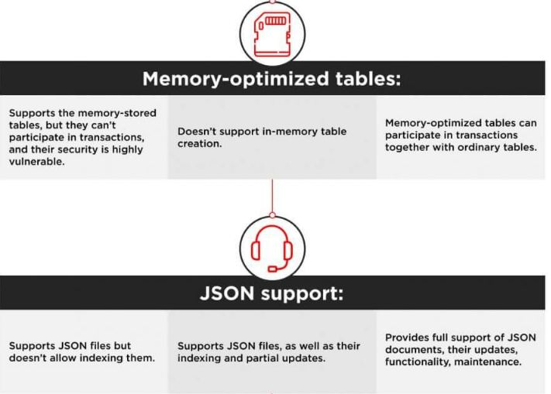
System Properties Comparison Microsoft SQL Server vs. MySQL vs. PostgreSQL

Slide 22
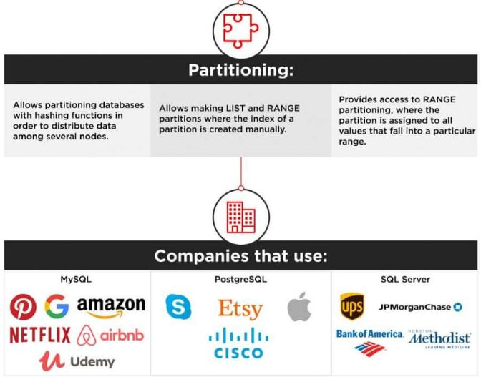
System Properties Comparison Microsoft SQL Server vs. MySQL vs. PostgreSQL

Slide 23
Conclusion
The choice between the three most popular databases (Microsoft SQL Server , MySQL and PostgreSQL)ultimately boils down to the comparison of the functionality, use cases, and ecosystems. Companies that prioritize flexibility, cost-efficiency, and innovation usually choose open-source solutions. They can be integrated with multiple free add-ons, have active user communities, and are continuously updated.
For corporations that prefer traditional commercial solutions, software like SQL Server backed up by a big corporation and compatible with an extensive infrastructure, is a better bet. They have access to constant technical support, personalized assistance, and professional management tools.

